Slide 1
Ontological (In)Security:
Nation, Space and Religion
Catarina Kinnvall
Department of Political Science
Lund University

Slide 2
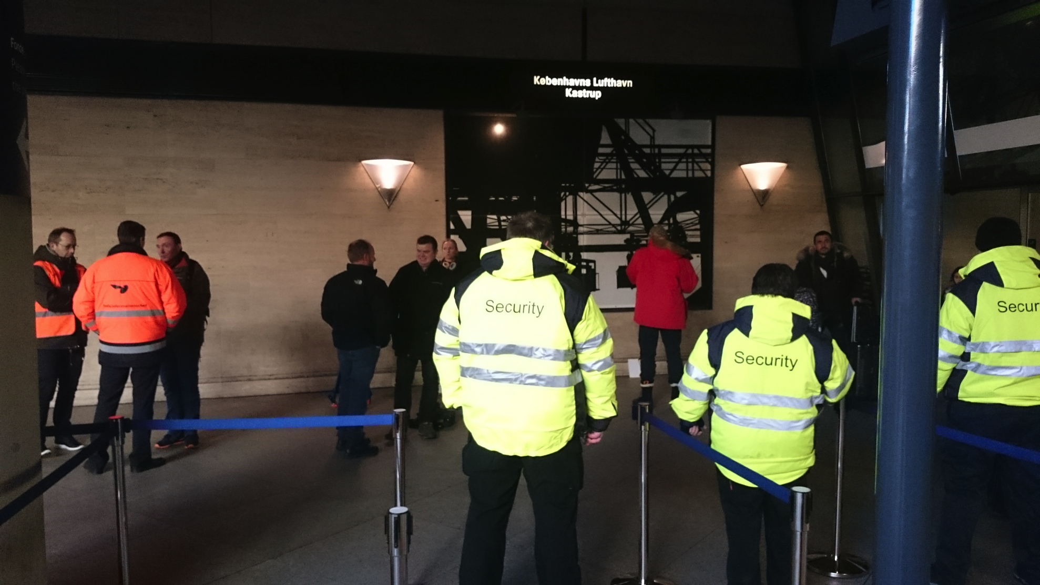
“The human capacity to injure other people is very great precisely because our capacity to imagine other people is very small” Elaine Scarry

Slide 3
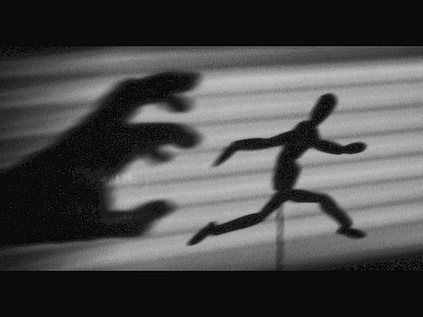
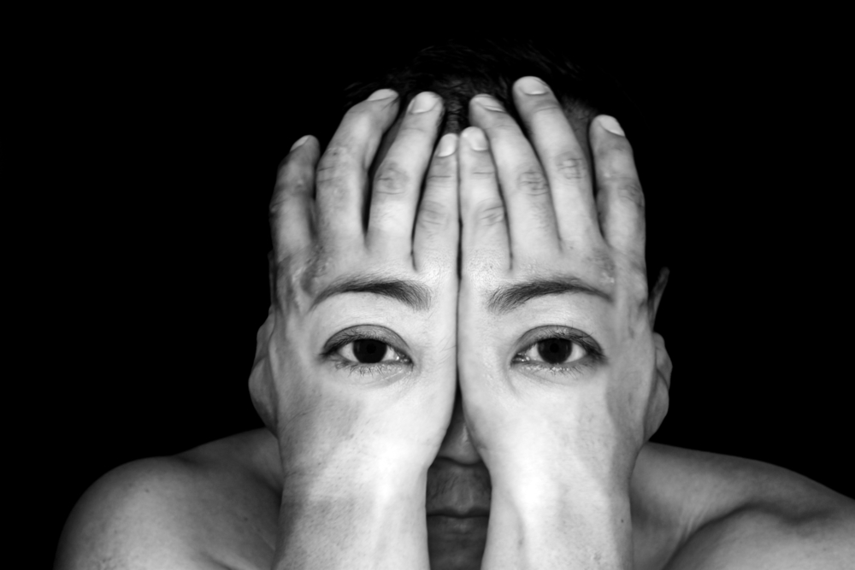
OVERVIEW
- Ontological (in)security
- The securitization of subjectivity and a politics of fear
- Narratives of collective memory and trauma
- Nationhood, nationalism and religion
- Gendered Space
- Examples from a European and South Asian context

Slide 4
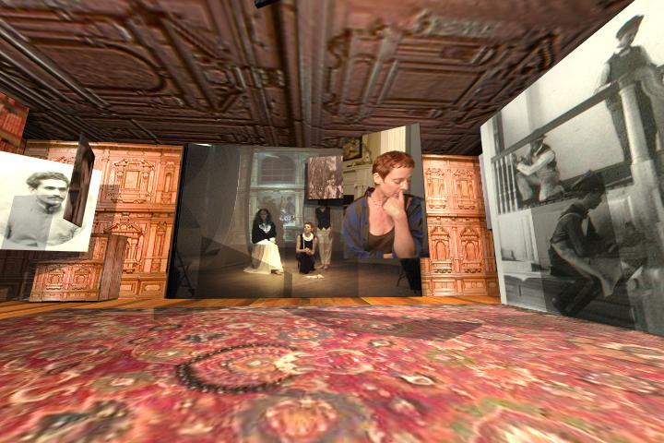
Securitizing subjectivity
Build walls around an idea of the ’self’
Essentialize and merge self and identity
Narrow conception of identity boundaries

Slide 5

The search for ontological security –
the imagination of a core self
Linking narratives of the individual with the state – governing security
Narratives as co-constitutive and intersubjective
  allow for structural and unconsious effects
  demonstrate how gender works in and through these narratives

Slide 6
The co-production of a politics of fear
Narratives of fear:
Fear as constructed from above – emotional governance
Fear as a response to splitting and constant othering
  Co-produced by new nationalists and radical Islamists
  Convey meaning in relation to hegemonic narratives of
    National and European identity
    Muslim and Islamic identity
    Become narrative plots in a European trauma

Slide 7
Trauma and the governing of memories
External rupture
The trauma is repeated through narrative accounts of the event – the trauma never left
The re-telling of the trauma as a collective experience
  Fragmentation of a sense of self and security
  A search for a new kind of ontological security
      The securitization of subjectivty

Slide 8

Chosen traumas – Chosen glories: the psychological moment

Slide 9
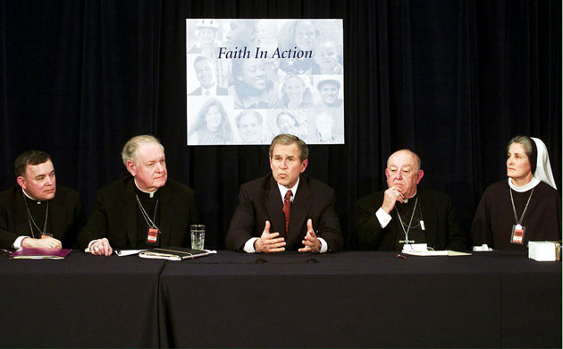

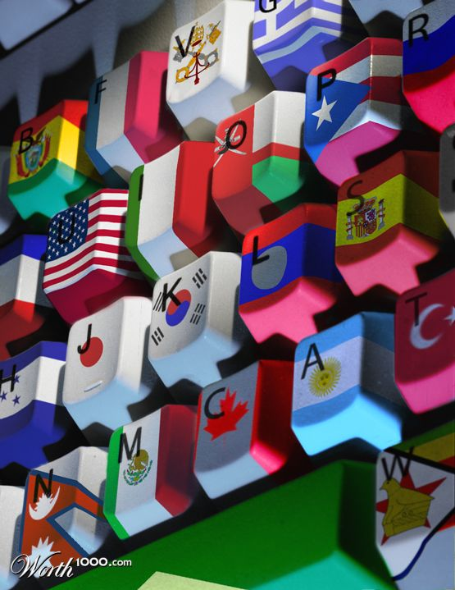
Provide important identity-signifiers
Make claims to a monolithic identity
Nationalism relies on the construction of ’the nation-as-this’ and ’the-people-as-one’
Narratives of nation and religion

Slide 10

Viewed as distinct entity
God has set the rules – difficult to contest
Needs to create an origin beyond time and history
A stabilizing anchor
Inclusiveness/exclusiveness, self/other
Need to buy into modernist discourse
Narratives of religion

Slide 11
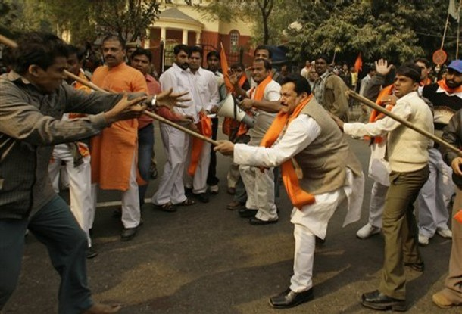

Slide 12
Icon of terrorism
The Muslim man
Plays into the discourse of the Hindu Right
Definition of territorial space as Hindu space
Terror carried out in Hindu space against Hindus

Slide 13

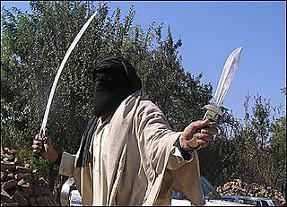
Europe and its Others – the enemy within
Governing of the nation – governing Europe
Governing Islam – governing Muslims

Slide 14
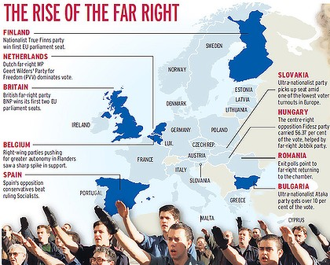

Slide 15
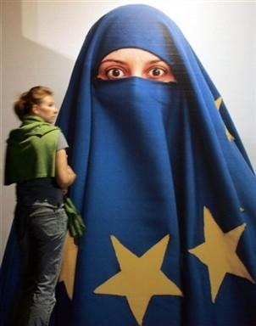
Gendered Space:
Gender issues as cultural conerns
Women as symbols of nationhood and religion
Genderng Islam in Europe
Muslim women as demographic bombs
Linked to version of masculinity
W-omen as ’Other’:
Politics of recognitiWomen as ’Other’:
Politics of recognition
Reassert control
Locating unacceptable characteristics
Gendering islam in Europ
Hegemonic traditionalists
The securitization of subjectivity
Control of ’womenandchildren’

Slide 16
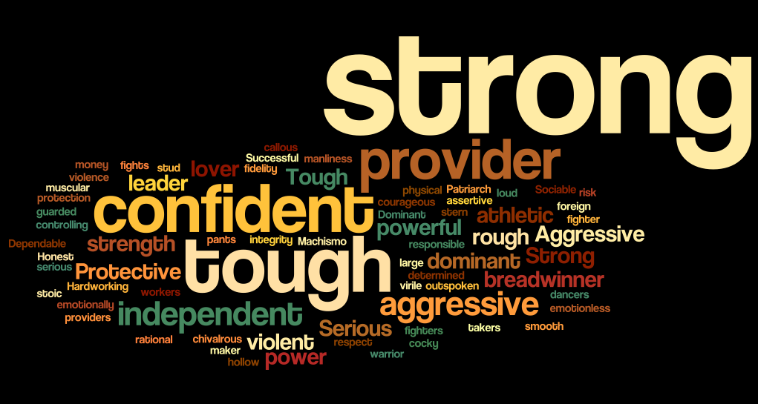
Hegemonic masculinity

Slide 17
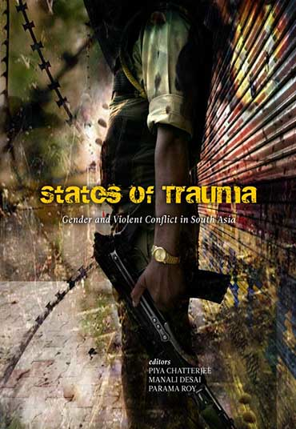
Viewing trauma in relation to gendered space and ontological (in)security
The continuation of the trauma in other forms
Symptomatic of the everyday – trauma as ongoing

Slide 18
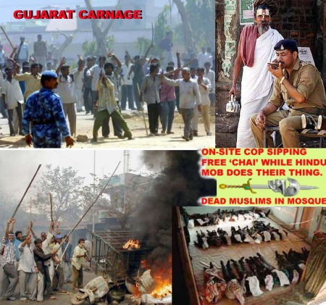

Slide 19

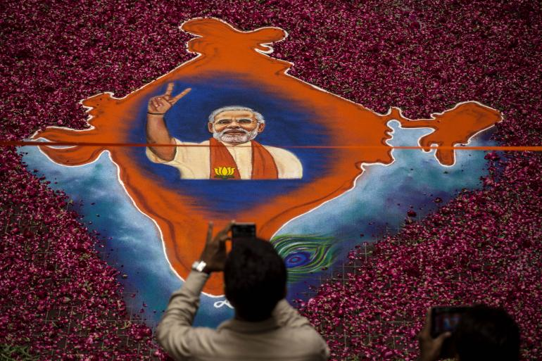
Governing ontologial (in)security:
Gendered space and violence
The extraordinary that is yet so ordinary
The relationship to patriarchic order

Slide 20

Sovereign power: The Sovereign as a prototype of masculinity
Absolute
Legitimate
Strong
Territorial
Divine
Immune
Legislative
Governing

Slide 21
Thank you!

